Slide 1
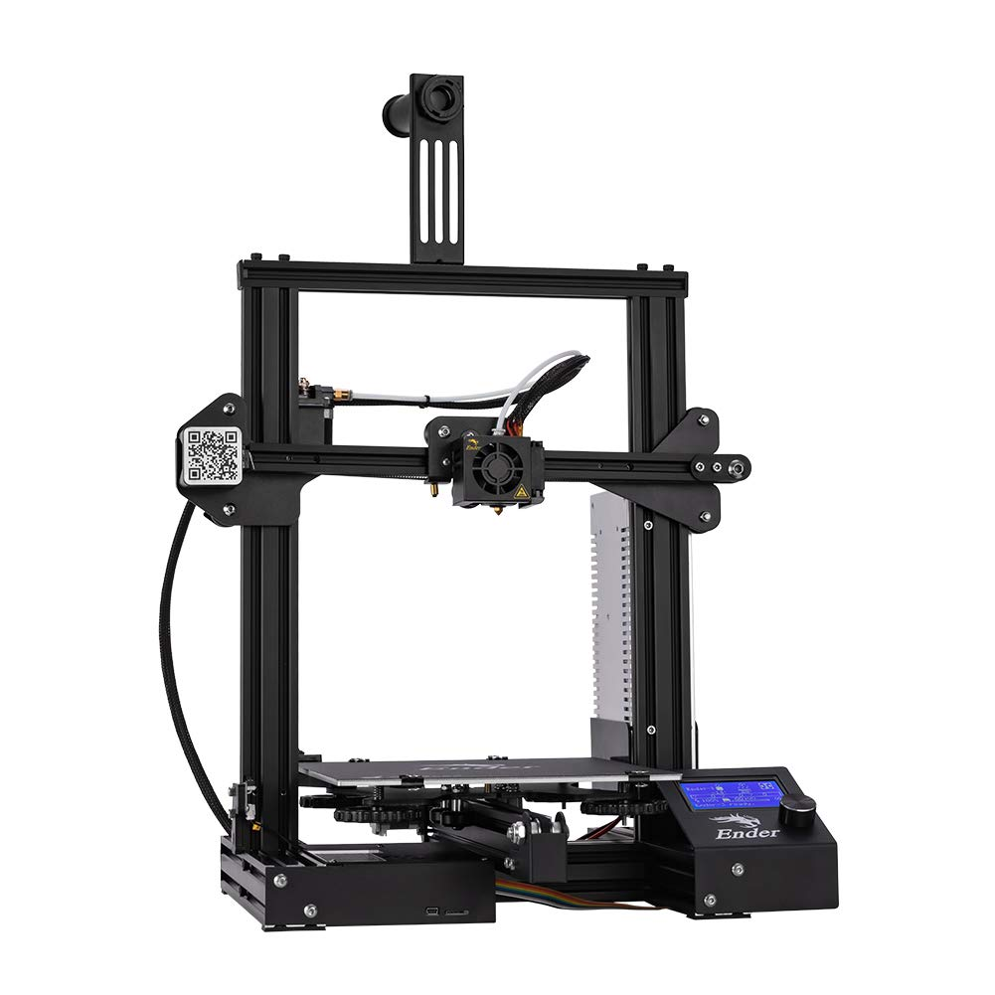

3D Printer and Application Interface Cody Hutchison
Steven Liu
Abigail Morar

Slide 2
Executive Summary
Problem Statement
Current 3D printers require the user to manually upload a G-code file by an external storage device and initiate the printing process via controls on the printer
Solution
The new 3D printer and Application will allow the uploading, controlling, and initiation of printing from anywhere with internet access
Quicker Z-axis motion
Print time within 10% of a regular Ender 3 Printer

Slide 3
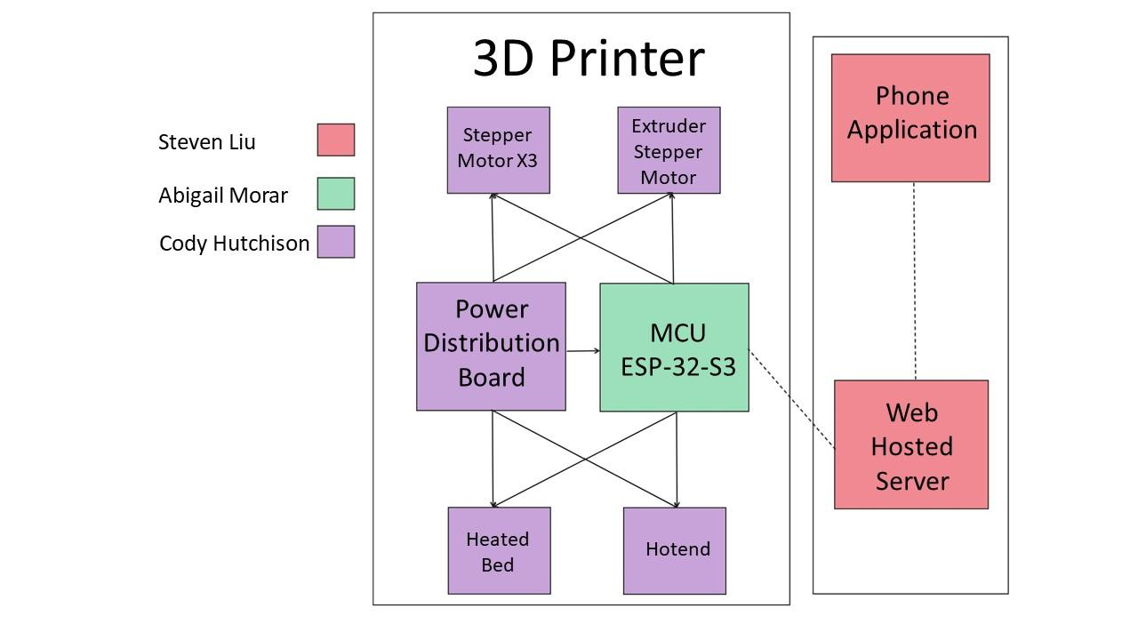
System Overview

Slide 4
Task Partition
Abigail: Program ESP32-S3
Cody: Design and build the Electrical Systems
Steven: Design and program the application and web hosted server

Slide 5
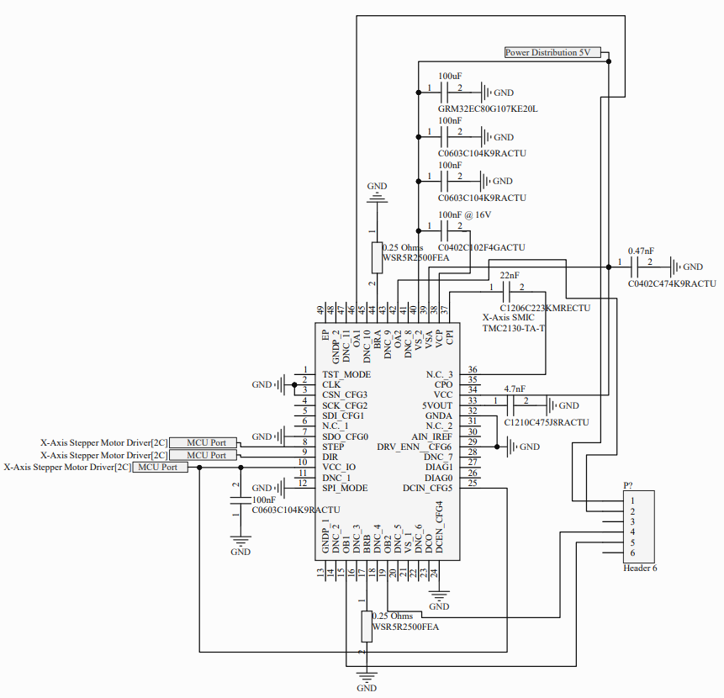
Electrical System Update
Accomplishments since the last presentation ~40hrs
Finished design of Stepper Motor Controllers and Power Distribution Started Schematics and PCB design Ordered major components including Stepper Motor Driver IC and DC-DC converter
Ongoing progress/problems and plans until the next presentation
Minor issue with the hot end and heated bed controlling with MOSFETs requiring a Digital-to-Analog converter Project going over budget Continue design of the schematics and PCB

Slide 6
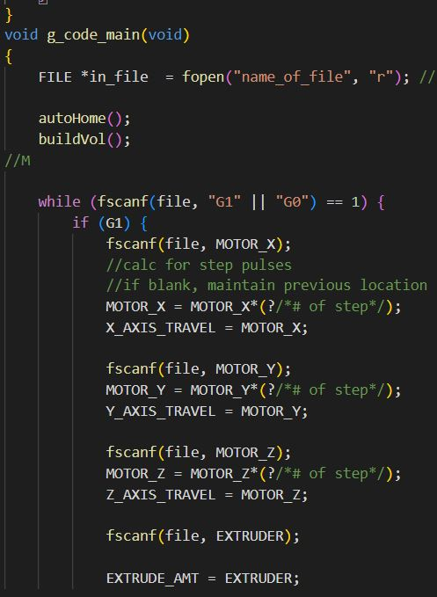
MCU Coding Update
Accomplishments since the last presentation ~15hrs
Setup Espressif IDE Set auto home and build volume parameters Reads in hard coded G-code files Stores lines of code in array Updates XYZ axis locations and extrusion amount
Ongoing progress/problems and plans until the next presentation
Finish converting G-code into C Controlling heated components and motors Communicating with phone application WiFi connection

Slide 7
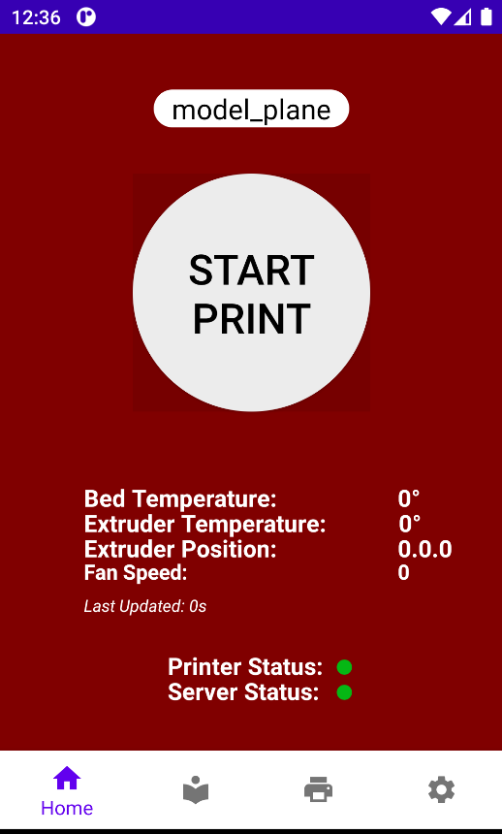
Phone Application and Server Update
Accomplishments since the last presentation ~20hrs
Finished App Navigation design Established communication between fragments (tab/pages) Connected application to Firebase, set up dependencies Set up firebase realtime database
Ongoing progress/problems and plans until the next presentation
Finish adding all UI features to application Establishing simple communication to firebase server and view database in scrollview (visual library of files)

Slide 8
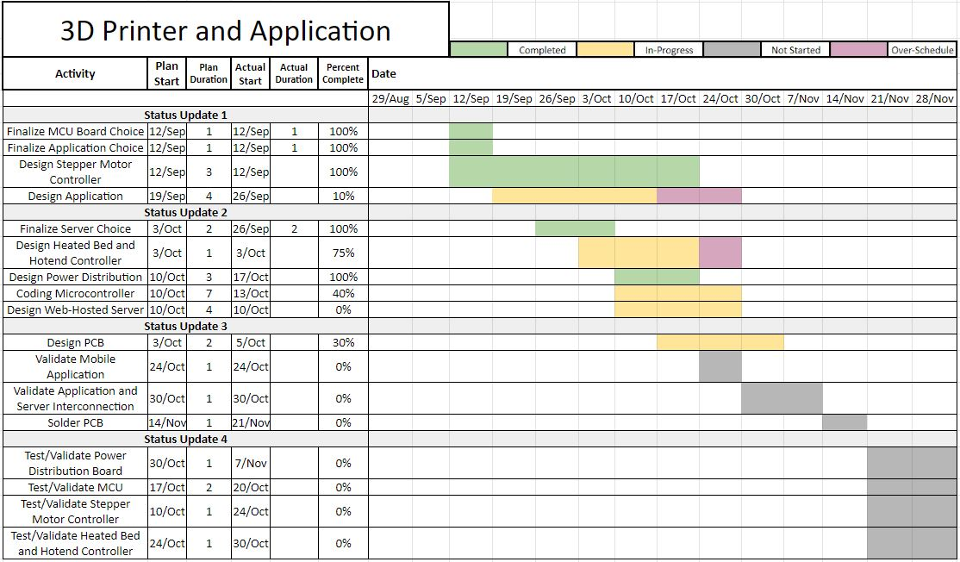
Execution Plan

Slide 9
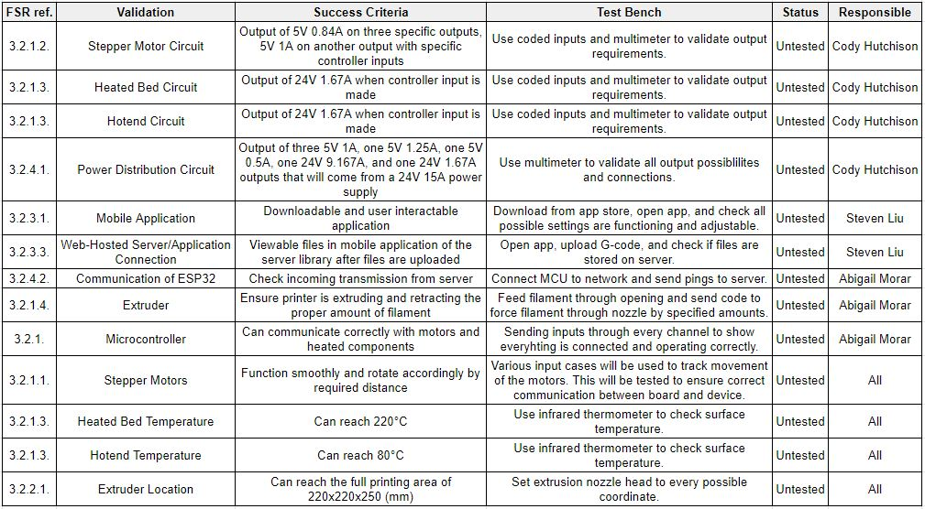
Validation Plan

